Slide 1

Kerberos-based Big Data Security Solution and Practice in Alibaba Cloud HBase
Jiajia Li @ Intel
Chao Guo @ Alibaba
August 17,2018

Slide 2
Content
Hadoop Authentication Service
01
02
Security Practice in ApsaraDB for HBase

Slide 3
Hadoop Authentication Service
01
Jiajia Li Intel

Slide 4
Content
1.1
Background
1.2
Introduction to HAS
1.3
Outlook and Summary

Slide 5
Background
1.1

Slide 6
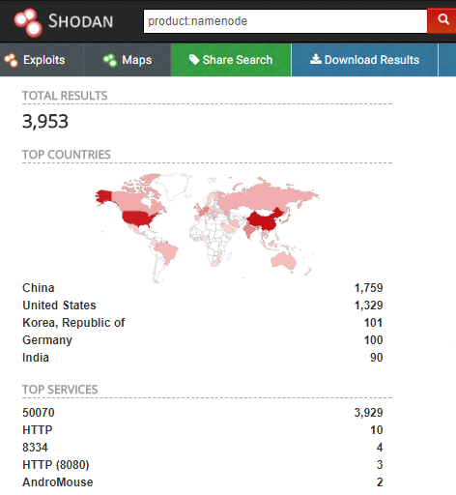
Background
Motivations
Jan 2017, The ransomware attacks on poorly secured MongoDB （Over 27000 MongoDB Databases Held For Ransom Within A Week), cyber crooks have started targeting unprotected Hadoop Clusters as well (Hadoop, CounchDB Next Targets in Wave of Database Attacks), until now, large amounts of Hadoop cluster data is still exposed in the public network (Insecure Hadoop Clusters Expose Over 5,000 Terabytes of Data).

Slide 7





Background
Multiple Ways to Attack Insecure Hadoop Cluster
Service
User
I’m Datanode
login with hadoop
Hadoop* Cluster
hadoop fs -rmr /
HDFS with ACL
superuser: hadoop

Slide 8








Background
How to Secure a Hadoop Cluster
Authentication
Authorization
Authentication
Kerberos is the right approach adopted for Hadoop security
MIT Kerberos, Azure AD, HAS
Authorization
Apache Sentry(Cloudera), Apache Ranger(Hortonworks)

Slide 9
Introduction to HAS
1.2

Slide 10
Introduction to HAS
Challenges for the Existing Solution
Hard to integrate existing identity management systems of enterprises to Kerberos
Over the past few years, multiple cloud providers have introduced Hadoop-as-a-Service and more organizations consider the cloud as a component of their Hadoop deployments
Java lacks a comprehensive Kerberos library. The Kerberos support in Java/JRE is:
Limited, lacking full encryption and checksum types
Hidden from GSSAPI/SASL layers
Evolving slow
Very difficult in Kerberos cluster deployment
Kerberos is essentially a protocol, or secure channel, doesn’t have to be that complex to most or normal users, hiding the details

Slide 11


Introduction to HAS
HAS System Architecture
Active Directory
HAS Server
Hadoop
Token Authority
LDAP
1
HAS Client
2
5
HAS is a secure and extensible authentication framework for addressing the problem of integration of enterprise identity with Kerberos centric Hadoop ecosystem.
RDMS
OAuth
3
4
6
SSO (SAML)
KDC (Kerby)
Kerberos Client
PKI
Kerberos
OTP
HAS Token
Enterprise Identity
Kerberos Token

Slide 12




Introduction to HAS
Key points of HAS implementation
t
Hadoop services continuously use the original Kerberos authentication mechanism.
Hadoop users can also continue to log in using a familiar authentication mode.
In the new authentication mechanism, the combination of your plugin and the existing authentication system can be customized and implemented.
Based on the new authentication mechanism, security administrators don’t need to synchronize user account information to the Kerberos database.

Slide 13
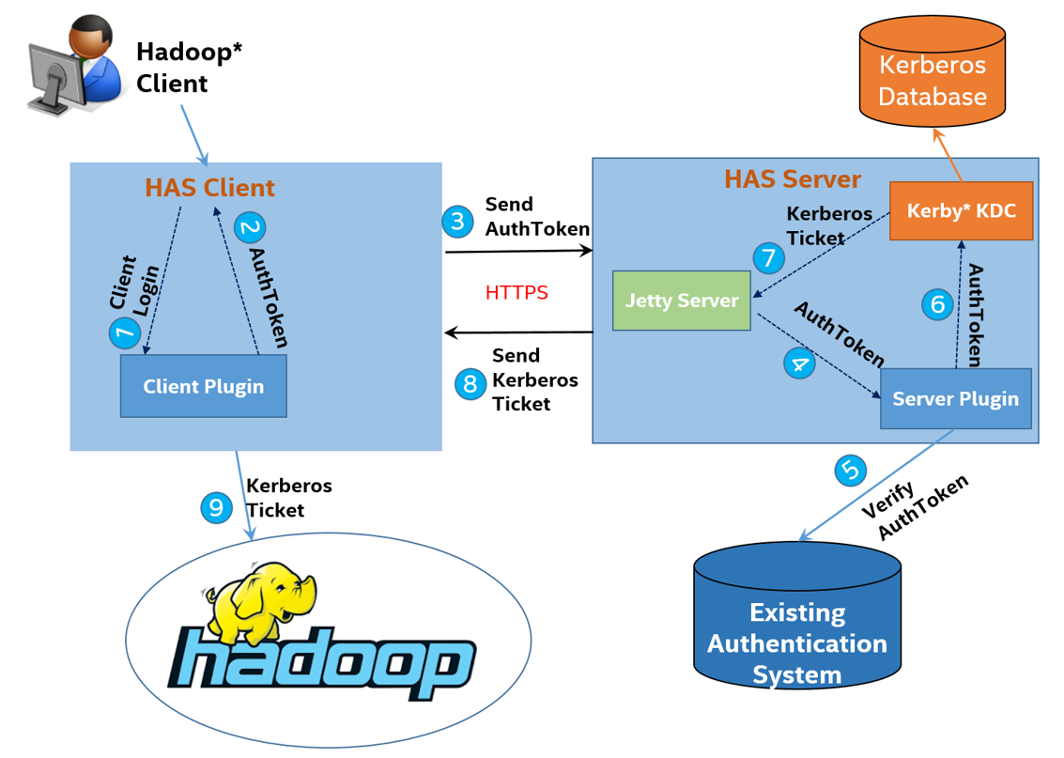
Introduction to HAS
HAS protocol flow

Slide 14
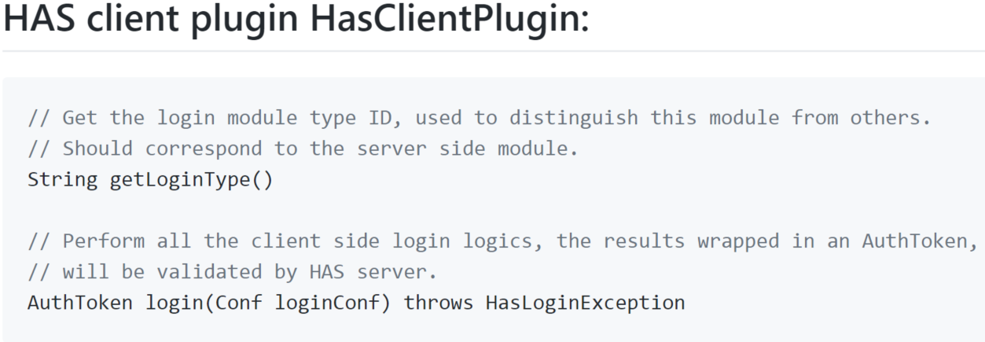
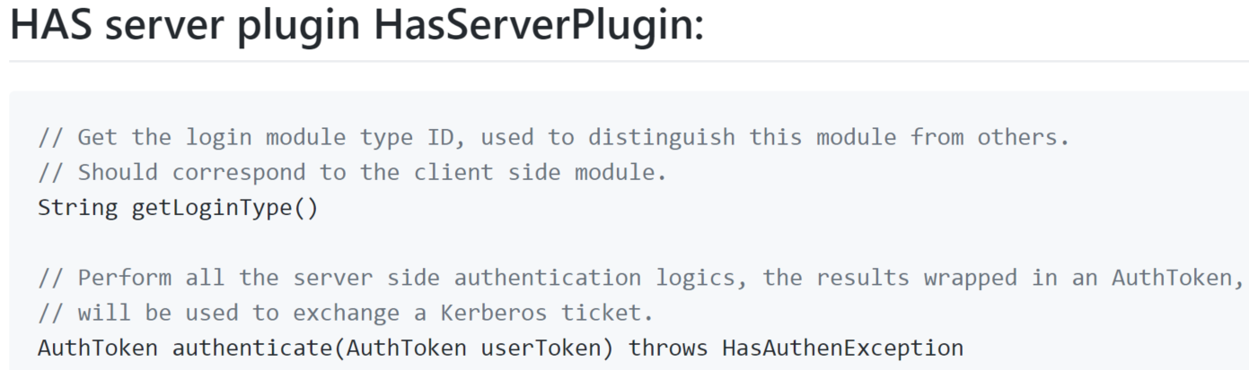
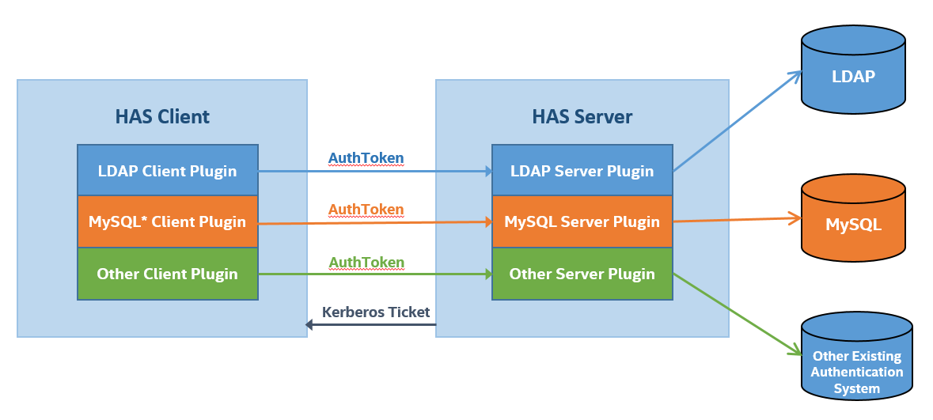
Introduction to HAS
HAS plugins

Slide 15
Outlook and Summary
1.3

Slide 16
Outlook and Summary
The new authentication mechanism (Kerberos-based Token Authentication) provided in HAS supports most components in the Hadoop ecosystem and makes little or no change to the components.
HAS open source in the branch of Apache Kerby project (https://github.com/apache/directory-kerby/tree/has-project).
HAS will be merged to trunk in the master JIRA (https://issues.apache.org/jira/browse/DIRKRB-671).
According to the community plan, the HAS feature will be released in Kerby 2.0.0, and Kerby 2.0.0 will be released in the near future.

Slide 17
Security Practice in ApsaraDB for HBase
02
Chao guo Aliyun

Slide 18
Content
2.1
Introduction to Apache HBase Security
and Security of ApsaraDB for HBase
2.2
ApsaraDB for HBase Optimization base on HAS
2.3
Outlook and summary

Slide 19
Introduction to Apache HBase Security and Security of ApsaraDB for HBase
2.1

Slide 20
Introduction to Apache HBase Security and Security of ApsaraDB for HBase
Introduce to Apache HBase Security
Apache HBase Security includes :
1. Access control Label base on Access Controller coprocessor;
2. Using Secure HTTP for Web UI.
3. Kerberos authentication for RPC;
User
Auth client
Https WEB
Apach HBase
ACL
SASL RPC
HTTPS
HDFS
DN
NN
zookeeper

Slide 21
Introduction to Apache HBase Security and Security of ApsaraDB for HBase
Introduction to ApsaraDB for Hbase security
Public networker user
Classic network user
White list
Plugin authentication
Other mechanism
User VPC/Classic
Network Isolation
ApsaraDB for HBase
text
HAS
ACL
HTTPS
Authentication
AUDIT
QUOTA
ENCRYPT
ApsaraDB for HBase main function:
Network Isolation and white list;
HAS authentication;
…

Slide 22
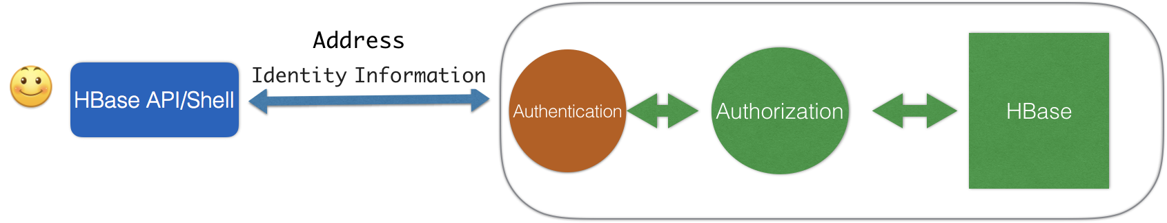
Introduction to Apache HBase Security
and Security of ApsaraDB for HBase
Instal MIT kerberos at the locality;
Set up local krb5.conf，the Kerberos service address，realm and so on of the HBase;
User name and local system user name should be the same, If got no user, need create；
Set up security configuration in hbase-site.xml,core-site.xml,hdfs-site.xml.For example:hadoop.security.authentication，dfs.namenode.kerberos.principal;
Do kinit, run kinit throw user passwor mode or keytab, get the legal user tiket;
Access to hbase throw hbase shell .
text
VS
Set up hbase zookeeper address, user’s password and name;
Access to hbase throw hbase shell .

Slide 23
Introduction to Apache HBase Security
and Security of ApsaraDB for HBase
User experience
User’s needs start basically from security then low cost then good experience
User experience
Affinity
Simplified configuration；easy to use
Cost
Reduce the cost of operation and maintenance, perfermance
Security
network isolation/whitelist/Authentication

Slide 24
ApsaraDB for HBase Optimization base on HAS
2.2

Slide 25
ApsaraDB for HBase Optimization base on HAS
Basical Introduction
Why choice HAS for us?
Kerberos is the only means to enable hadoop security
Compatible with existting security mechanism :ACL、keberos …
Easy to deploy
Easy to use for client
Good scalability
Performance is ok
Low operating cost；
…

Slide 26
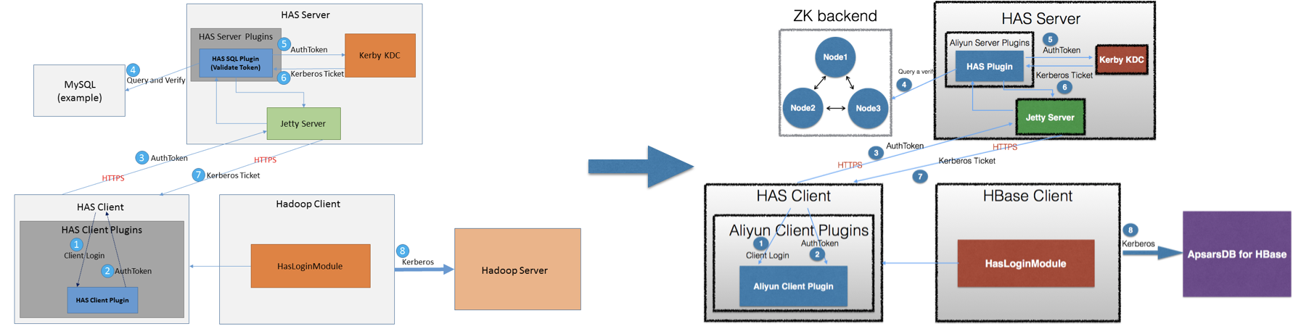
ApsaraDB for HBase Optimization base on HAS
ApsaraDB for HBase’s authentication improvement
Security and practice
Account password management
Whitelist for hosts and other securities
Using plugin for password and account management
High availability backend
Impement zookeeper like backend for storage of user name/password/whitelist host/kdcconf

Slide 27
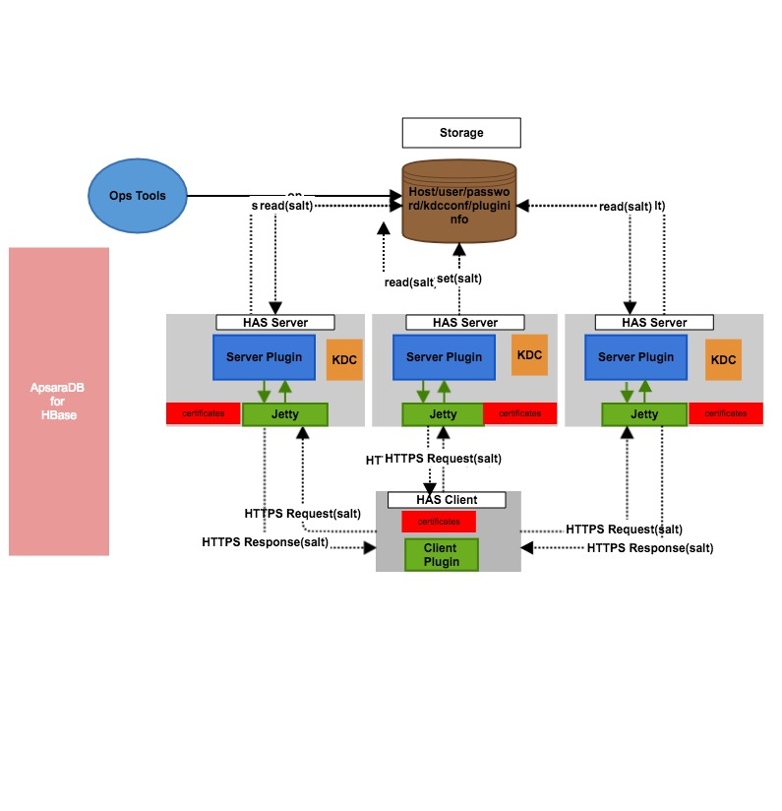
ApsaraDB for HBase Optimization base on HAS
Security and practice
HA for HAS server
White list for host access
Plugins use HTTPS(Initialiazation/usage)
Configurable salting algorithm
Backward compatible kerberos and all Hbase security
Ops tools : one button to deploy

Slide 28
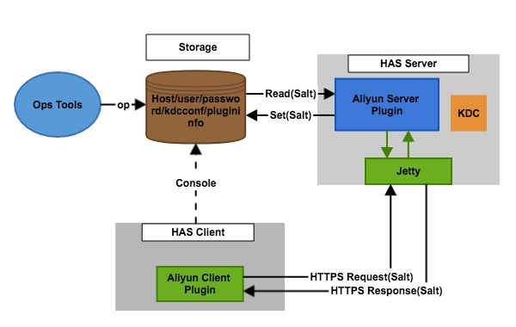
ApsaraDB for HBase Optimization base on HAS
Account password management
We have done some service on has like:
Aliyun Client/Server plugin mode
Client can initialize with their user/password/hosts
Client pass user/password throw https
Server plugin verify from storage with salt
The entire process is safe
Configure free,easy to use;
Other plugin mode:

Slide 29




ApsaraDB for HBase Optimization base on HAS
High availability backend
Mysql not fit for cloud environment
Single mysql is not ha , 2 or 3 node ha mysql not fit for cloud environment deployment , k-v format, zk is enough
High availability for backend storage
At least 3 replicas ,more available than mysql
Less resource and enough performance
Most value is less than 50B , less memory than mysql and enough performance

Slide 30
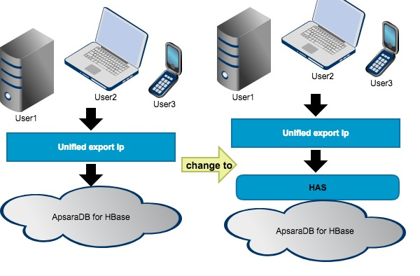
ApsaraDB for HBase Optimization base on HAS
Possible user case
User consulation case:
All users with same export Ip
ACL is not suitable
Users need different authentication
On Cloud almost one small cluster
for on user;
But private cloud and big cluster is
different;

Slide 31
Outlook and Summary
2.3

Slide 32
Outlook and Summary
For the security of ApsaraDB for HBase, we got network ioslation 、whitelist and other mechanism . As authentication ,we adopt HAS.
We have do some optimization for HAS such as ha、customized plugins.
The secure ApsaraDB for HBase is ready now. https://www.aliyun.com/product/hbase?spm=5176.8142029.388261.280.702b614asnEokD

Slide 33



Thanks
Dingding group for HBase
Personal Wechat

